Slide 1
Using dnsmasq as DNS and DHCP server
2014-4-17

Slide 2
Dnsmasq
Dnsmasq is a lightweight, easy to configure DNS forwarder and DHCP server.
It is designed to provide DNS and, optionally, DHCP, in a small network.

Slide 3
DNS&DHCP
1.DHCP：
  The Dynamic Host Configuration Protocol (DHCP) is a networking service used on IP computer networks,
  It is used for allocating IP addresses to computers.
2.DNS：
  The Domain Name System (DNS) is a hierarchical distributed naming system for computers, services, or any other resources connected to the Internet or a private network.
  It translates easily memorized domain names to the numerical IP addresses needed for the purpose of locating computer services and devices worldwide.

Slide 4
网络拓扑
DNS &DHCP Server
虚拟机1
Internet
eth0
nat
eth1
eth0
eth0
Host n
Host 1
……
虚拟机2
虚拟机n

Slide 5
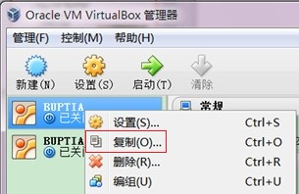
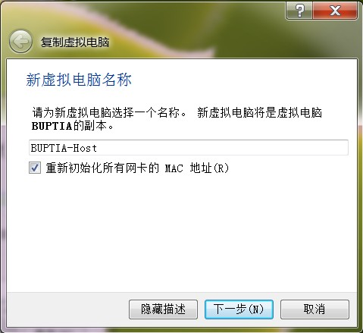
Prepare
Copy VM "BUPTIA"
  Right click
  Select copy
New name
  As "BUPTIA-Host"
Check reinitiate MAC
Completely Copy

Slide 6
Server side configuration on BUPTIA VM

Slide 7
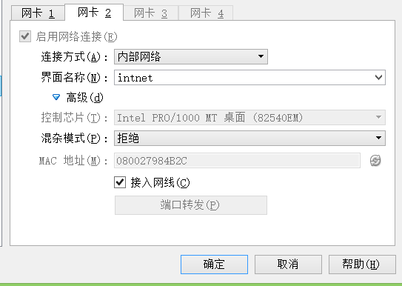
Network
右键-〉网络配置-〉网卡2

Slide 8
Network
1.sudo su
2. rm /etc/udev/rules.d/70-persistent-net.rules
Restart VM of server side

Slide 9
Install dnsmasq
1.sudo su
2.apt-get update（optional）
3.apt-get install dnsmasq

Slide 10

Configure DNS Server（1）
vi /etc/dnsmasq.conf
  resolv-file=/etc/dnsmasq.resolv.conf
    (default resolv.conf )
  addn-hosts=/etc/dnsmasq.hosts
  conf-dir=/etc/dnsmasq.d

Slide 11
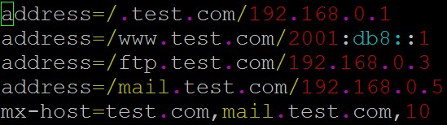
Configure DNS Server（2）
vi /etc/dnsmasq.d/zones-test.com
cd /etc
cp resolv.conf dnsmasq.resolv.conf

Slide 12

Configure DNS Server （3）
vi /etc/dnsmasq.hosts
  e.g
service dnsmasq restart

Slide 13
Configure DHCP Server
vi /etc/dnsmasq.conf
  1) interface=eth1
  2) dhcp-range=192.168.0.10, 192.168.0.50,12h
  3) dhcp-option=3, 192.168.0.1(Gateway)
    dhcp-option=6, 192.168.0.1(DNS server)
service dnsmasq restart

Slide 14
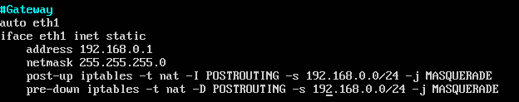
Configure interface
vi /etc/network/interfaces
vi /etc/sysctl.conf
    In the file, add
      net.ipv4.ip_forward=1
sysctl -p
/etc/init.d/networking restart

Slide 15
Client side configuration on BUPTIA-Host VM

Slide 16
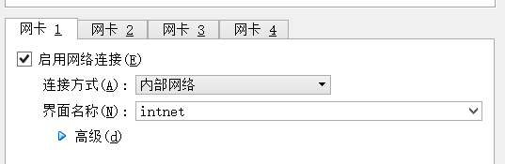
Network
1.

Slide 17
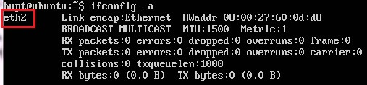
Configure interface
sudo su
ifconfig -a
  find out the interface name
  e.g. "eth2"
vi /etc/network/interfaces
  find "auto eth0" and "iface eth0 inet dhcp"
  change both "eth0" to "eth2"
/etc/init.d/networking restart

Slide 18
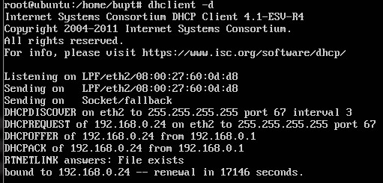
DHCP testing
DHCP
  dhclient -d

Slide 19


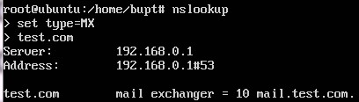
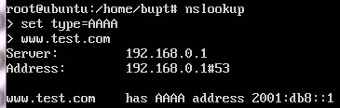
DNS testing
DNS
  nslookup dns.test.com
  nslookup 11.11.11.11
  nslookup query with "MX" type
  nslookup query with "AAAA" type

